Slide 1
Object-oriented Programming
Week 13 | Lecture

Slide 2
default arguments in c++
A default argument is a value provided in a function declaration that is automatically assigned by the compiler if the caller of the function doesn’t provide a value for the argument with a default value.

Slide 3
Rule 1
Default arguments must be the rightmost (trailing) arguments in a function’s parameter list. default arguments are assigned from right to left
Once we provide a default value for a parameter, all subsequent parameters must also have default values. For example,

Slide 4
// Invalid
void add(int a, int b = 3, int c, int d);
// Invalid
void add(int a, int b = 3, int c, int d = 4);
// Valid
void add(int a, int c, int b = 3, int d = 4);

Slide 5
Operator Overloading
C++ allows you to specify more than one definition for an operator in the same scope, which is called operator overloading.
You can redefine or overload most of the built-in operators available in C++
It is a type of polymorphism in which an operator is overloaded to give user defined meaning to it.

Slide 6
Operator Overloading
An operator is overloaded by writing a non-static member function definition or global function definition
When operators are overloaded as member functions, they must be non-static
To use an operator on class objects (as operands), that operator “must” be overloaded

Slide 7
Operator Overloading
Operator overloading works when at least one argument of that operator is an object
We cannot create new operators using operator overloading

Slide 8
LIST OF OPERATORS THAT CAN’T BE OVERLOADED
Almost any operator can be overloaded in C++. However there are few operator which can not be overloaded.
scope operator (::)
sizeof
member selector –(.)
member pointer selector – (.*)
ternary operator – (?:)

Slide 9
Works fine
#include <iostream>
using namespace std;
int main() {
int a=5;
int b=3;
int z=a+b;
cout << z;
return 0;}

Slide 10
Output?
#include <iostream>
using namespace std;
class Complex {
private:
int real;
int image;
public:
Complex(){
real = 0;
image = 0; }
Complex(int r, int i){
real = r;
image = i;}

Slide 11
Output?
void displayComplex() {
cout << "real: "<< real << " Imaginary:" <<image <<endl; }};
int main() {
Complex c1(2,1);
Complex c2(3,1);
Complex c3;
c3=c1+c2;
return 0;}

Slide 12
Output
[Error] no match for 'operator+' (operand types are 'Complex' and 'Complex')

Slide 13
criteria/rules to define the operator function:
In case of a non-static function, the binary operator should have only one argument and unary should not have an argument.

Slide 14
Syntax of Operator Overloading
Return type operator op(argument list);
return_type class_name : : operator op(argument_list)
{
// function body
}

Slide 15
Example of Operator Overloading
class Complex {
private:
int real;
int image;
public:
Complex(){
real = 0;
image = 0; }
Complex(int r, int i){
real = r;
image = i;}

Slide 16
Example of Operator Overloading
void displayComplex() {
cout << "real: "<< real << " Imaginary:" <<image <<endl; }
// overloaded (+) operator
Complex operator+ (Complex c) {
Complex temp;
temp.real=real+c.real;
temp.image=image+c.image;
return temp;
}};

Slide 17
Example of Operator Overloading
int main() {
Complex c1(2,1);
Complex c2(3,1);
Complex c3;
c3 = c1.operator+ ( c2 );
//c3=c1+c2;
c3.displayComplex();
return 0;}

Slide 18
c3=c1+c2; // statement 1
It is same like
c3=c1.add(c2); just for understanding
In statement 1, Left object c1 will invoke operator+() function and right object c2 is passing as an argument.
Another way of calling binary operator overloading function is to call like a normal member function as follows,
c3 = c1.operator+ ( c2 );

Slide 19
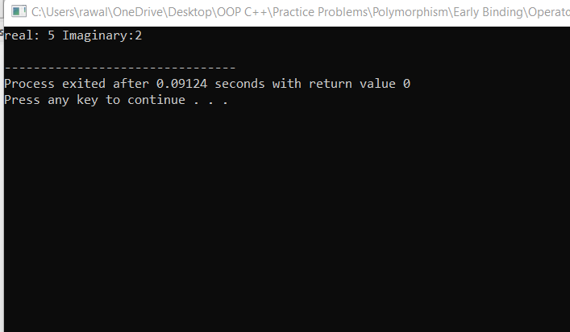

Slide 20
int main() {
Complex c1(2,1);
Complex c2(3,1);
Complex c3(1,1);
Complex c4;
c4=c1+c2+c3;
c4.displayComplex();
return 0;}

Slide 21
c4=c1+c2+c3;
Firstly addition of c2+c3 happen then the result of c2+c3 added to c1 and stored in c4 here add function called two times

Slide 22
“-” Operator
#include <iostream>
using namespace std;
class Distance {
private:
int feet; // 0 to infinite
int inches; // 0 to 12
public:
// required constructors
Distance() {
feet = 0;
inches = 0;
}
Distance(int f, int i) {
feet = f;
inches = i;
}
// method to display distance
void displayDistance() {
cout << "F: " << feet << " I:" << inches <<endl;
}
// overloaded minus (-) operator
Distance operator- () {
feet = -feet;
inches = -inches;
return Distance(feet, inches);
}
};

Slide 23
int main() {
Distance D1(11, 10), D2(-5, 11);
-D1; // apply negation
D1.displayDistance(); // display D1
-D2; // apply negation
D2.displayDistance(); // display D2
return 0;
}

Slide 24
For Prefix ++ operator
void operator ++ ( )
{
++x;
++y;
}
(Works the same way for prefix decrement operator)

Slide 25
For Prefix ++ operator
class Prefix{
int i;
public:
Prefix(): i(0) { }
void operator ++()
{ ++i; }
void Display()
{ cout << "i=" << i << endl; }};
int main(){
Prefix obj;
obj.Display();
++obj;
//you can also write obj.operator ++();
obj.Display();
return 0;}

Slide 26
distinguish between post and prefix
The operator symbol for both prefix(++i) and postfix(i++) are the same. Hence, we need two different function definitions to distinguish between them. This is achieved by passing a dummy int parameter in the postfix version.

Slide 27
For Postfix ++ Operator
Vector operator ++ ( int )
{
Vector temp;
temp.x = x++;
temp.y = y++;
return temp;
}

Slide 28
For Postfix ++ Operator
#include<iostream>
using namespace std;
class Postfix{
int i;
public:
Postfix(): i(0) { }
void operator ++(int)
{ i++; }
void Display()
{ cout << "i=" << i << endl; }};
int main(){
Postfix obj;
obj.Display();
obj.operator ++(4);//for this syntax you must have to pass a dummy value
// you can also write obj++;
obj.Display();
return 0;}

Slide 29
Difference between post and prefix
int y=0;
y=x++;
cout <<x;
cout<<y;

Slide 30
X=1
Y=0
In postfix firstly substitute the value then increment happens

Slide 31
Output?
class Check{
int i;
public:
Check(): i(0) { }
Check operator ++ (int){
Check temp;
temp.i = i++;
return temp;}
void Display()
{ cout << "i = "<< i <<endl; }};

Slide 32
Output?
int main(){
Check obj, obj1;
obj.Display();
obj1.Display();
obj++;
obj.Display();
obj1.Display();
return 0;}

Slide 33
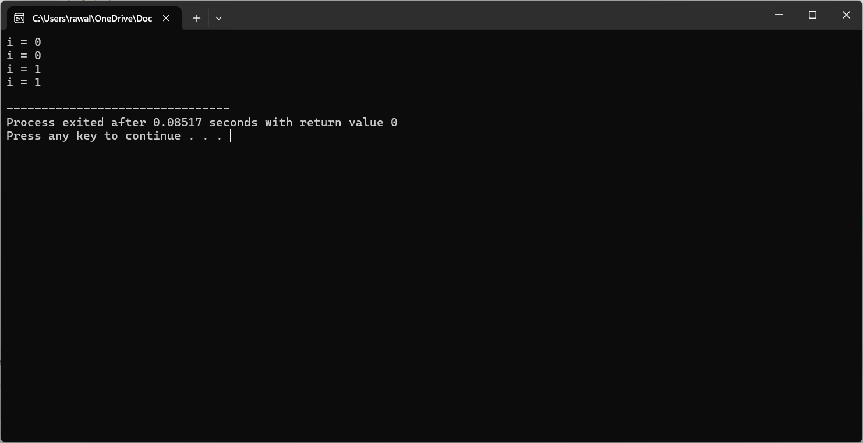
Output

Slide 34
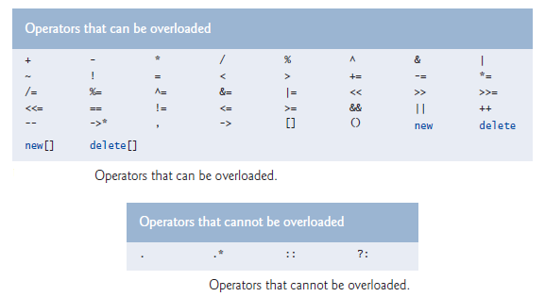
Restrictions on Operator Overloading

Slide 35
For += operator
Vector& operator += (const Vector &ob)
{ x += ob.x;
y += ob.y;
return *this;
}

Slide 36
For Unary - operator (Negation)
Vector operator – ( ) const
{ Vector temp;
temp.x = -x;
temp.y = -y;
return temp;
}

Slide 37
Next Lecture
Function Overriding

